Slide 1

CM3121 – Advanced Organic Chemistry
Dr. Zhu Ye
Office: S9-14/Tel: 66017501
chmzhu@nus.edu.sg
Oxidation Reactions

Slide 2
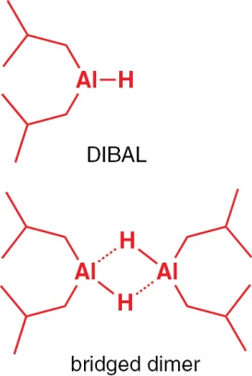
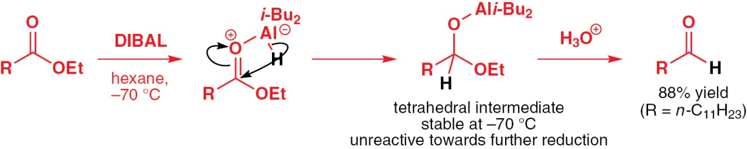
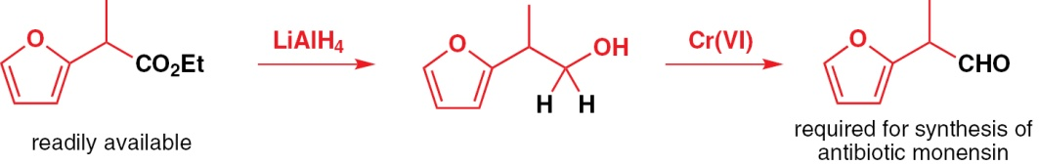
DIBAL-H
DIBAL-H (diisobutyl aluminium hydride, which is an alane): Partial Reduction (esters to aldehyde): at low temperature Question: what is the other way to convert esters to aldehydes?
Reduction
Oxidation
Notes:
DIBAL only becomes a reducing agent upon forming a Lewis acid-base complex.

Slide 3
Oxidation
I. Oxidation of alcohols and aldehydes 1.1 Alcohols to aldehydes/ketones 1.2 Alcohols to carboxylic acids 1.3 Aldehydes to carboxylic acid II. Oxidation of C=C double bonds (previous lectures) 2.1 Epoxidation 2.2 Dihydroxylation 2.3 Ozonolysis

Slide 4
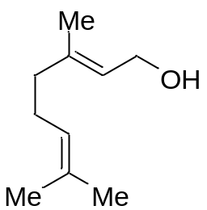

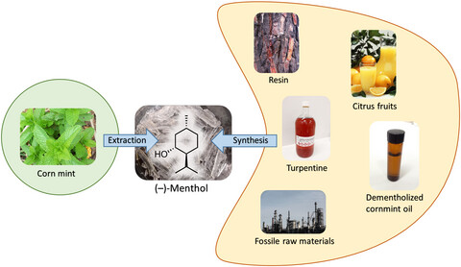
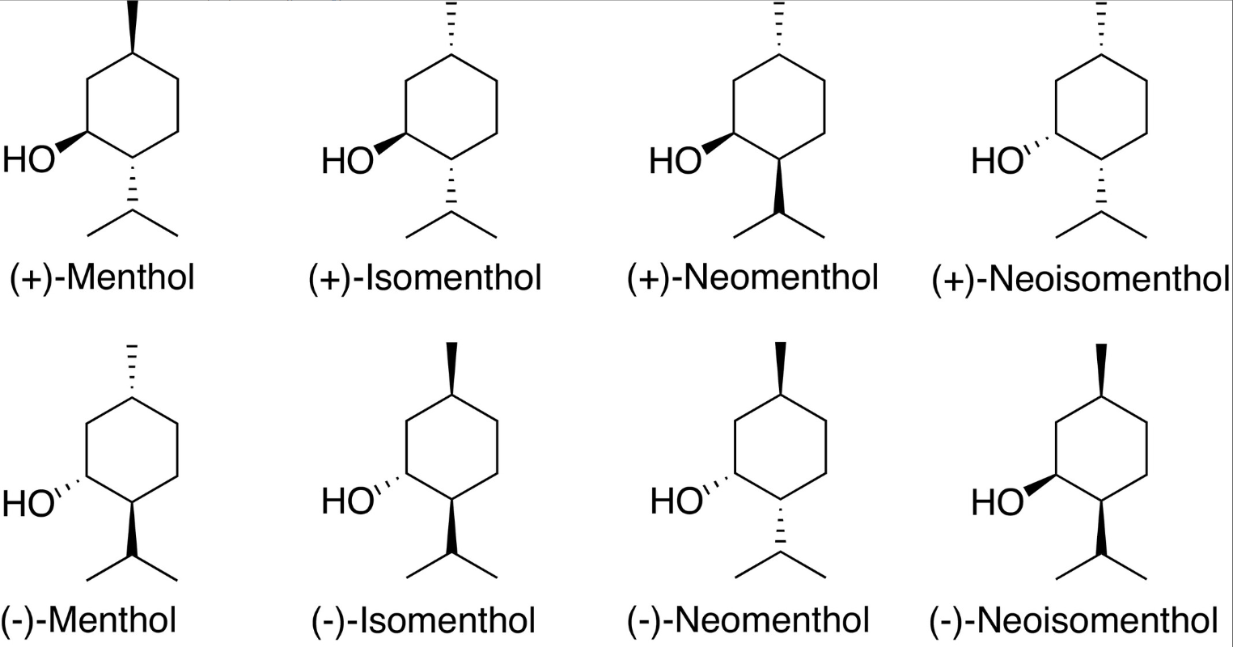
Alcohols
Geraniol has a characteristic rose-like odour and the taste (at 10 ppm) is described as sweet floral rose-like, citrus with fruity, waxy nuances. This monoterpene alcohol is a widely used fragrance material. A survey of consumer products revealed that it is present in 76% of investigated deodorants on the European market, included in 41% of domestic and household products and in 33% of cosmetic formulations based on natural ingredients and its production exceeds 1000 metric tons per annum.
Geraniol
(−)-Menthol is one of the most popular aroma compounds worldwide. While in the past mostly extracted from mint plants, today menthol is synthesized from other raw materials.

Slide 5
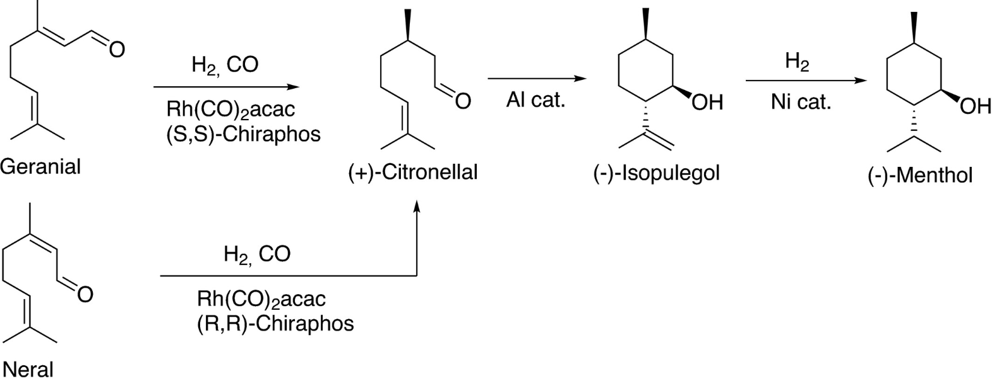
Geraniol
？

Slide 6
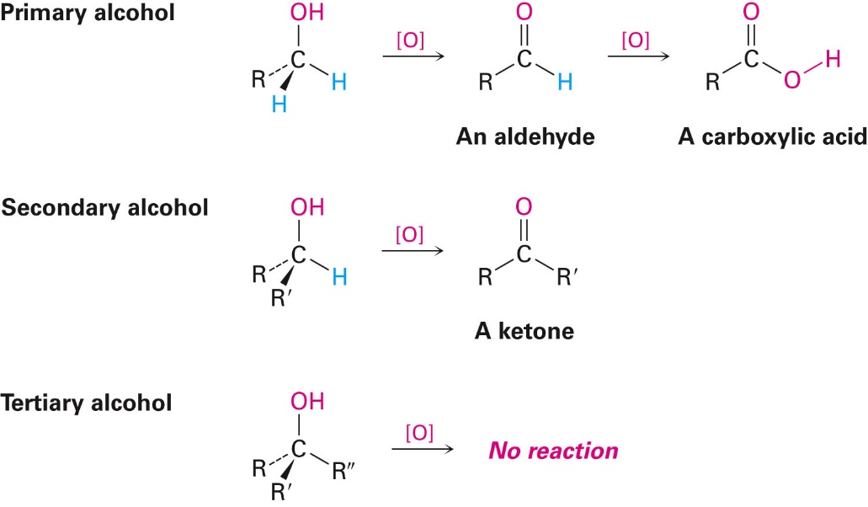
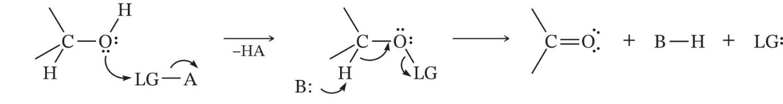
I. Oxidation of alcohol

Slide 7
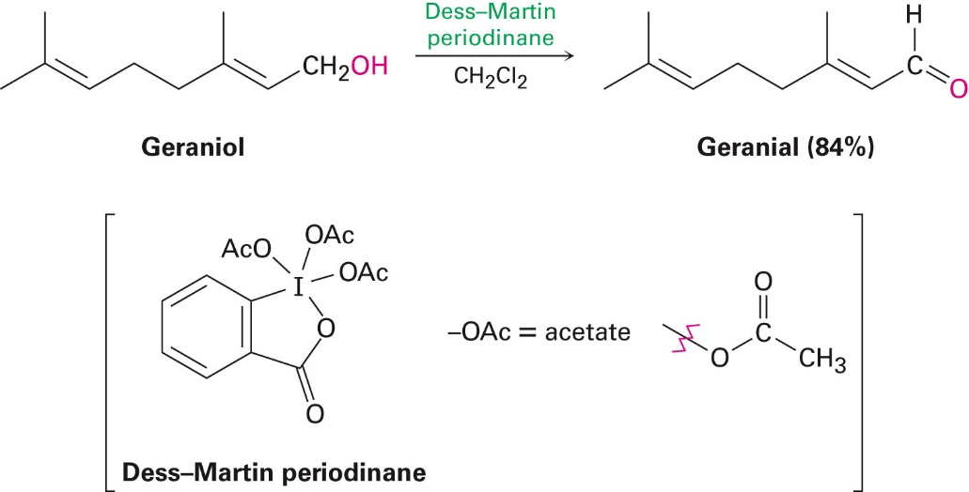
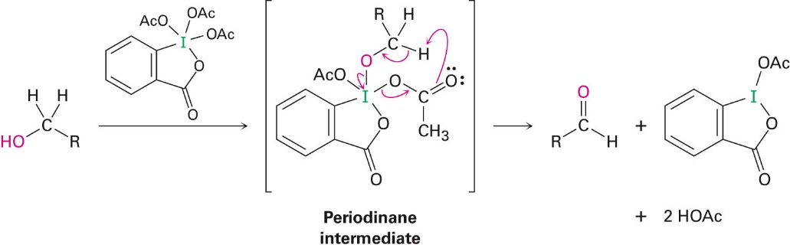
1.1 Alcohols to aldehydes/ketones (mild oxidizing agents)
i. Dess Martin Periodinane (DMP): “I-O” as the oxidant Reported in 1983 by D.B Dess and J.C Martin and emerged as a popular choice for oxidation of alcohols to the corresponding carbonyl compounds Reagent: pentacoodinate iodine (V)
Advantages:
Hypervalent iodine reagents have received particular attention because of their low toxicity, a favorable safety profile, easy handling, and an environmentally friendly nature
Mild reaction conditions (temp, neutral)
Tolerance of sensitive functional groups on complex substrates
mechanism

Slide 8
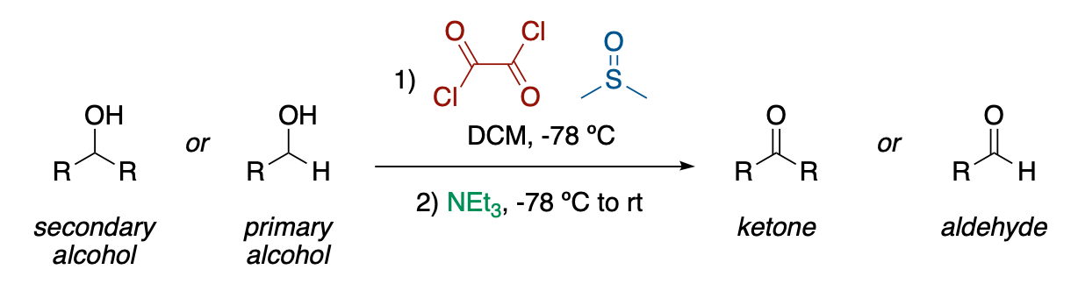
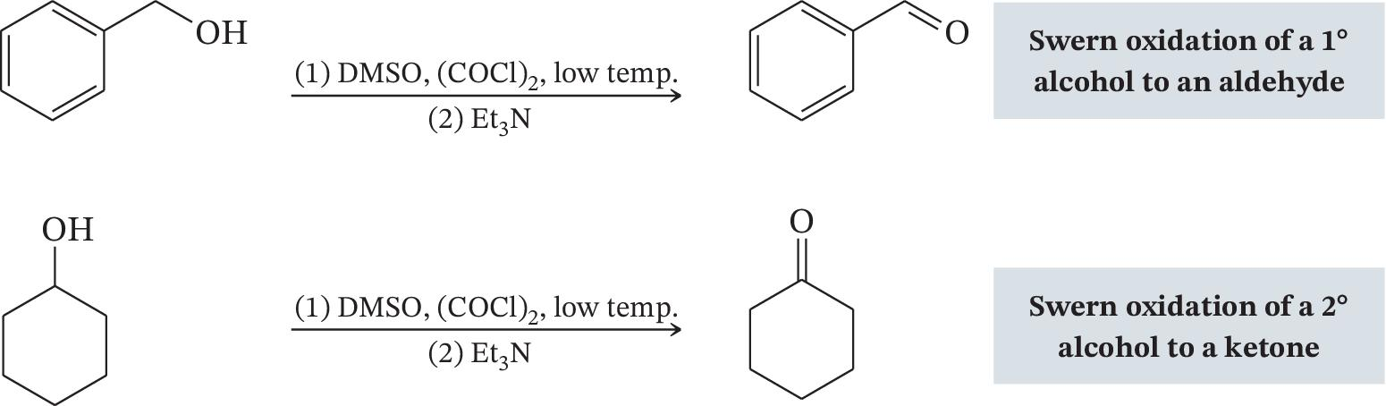
Mild oxidizing agents
ii. Swern oxidation (1976) “S-Cl” as the oxidant Reagents: dimethyl sulfoxide (DMSO) and oxalyl chloride (COCl)₂ Oxidize primary alcohols to aldehydes and secondary alcohols to ketones

Slide 9
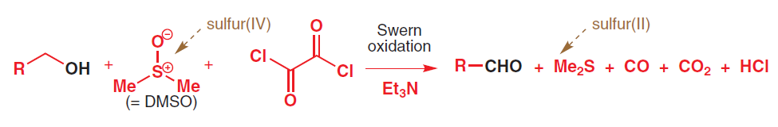
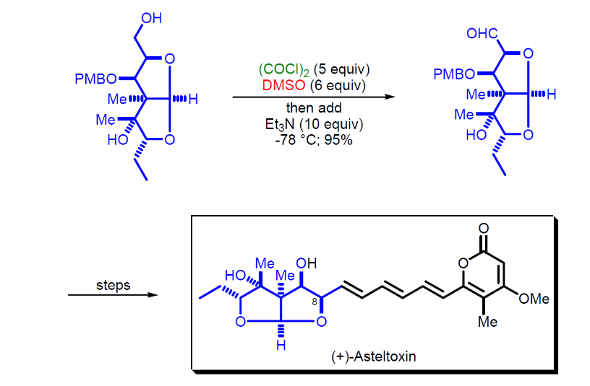
Mild oxidizing agents
Swern oxidation More examples: https://synarchive.com/named-reactions/swern-oxidation
The reagents are abundant and much more affordable than DMP. The reaction produces dimethyl sulfide ((CH₃)₂S), carbon monoxide (CO), carbon dioxide (CO₂) as by-products.

Slide 10
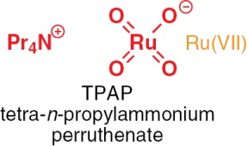
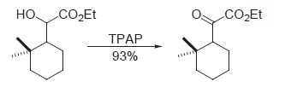
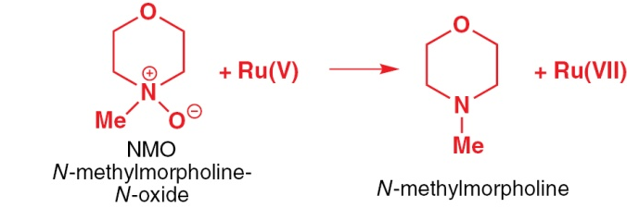
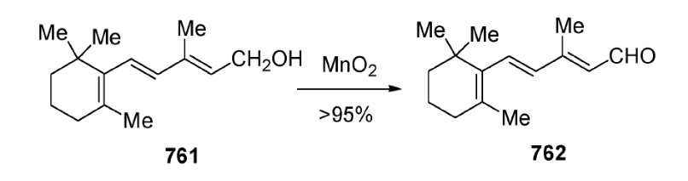

Metal oxides as mild oxidants
iii. TPAP/NMO “Ru-O” as the oxidant iv. Manganese dioxide (MnO₂) “Mn-O” as the oxidant MnO₂: very mild oxidizing reagent Selectively oxidizes allylic and benzylic alcohols to aldehydes and ketones
(TPAP can be used in catalytic amount using NMO as the terminal oxidant)
Ley-Griffith Oxidation

Slide 11
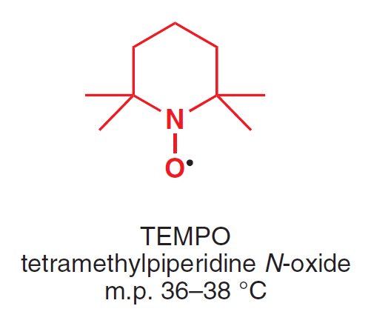
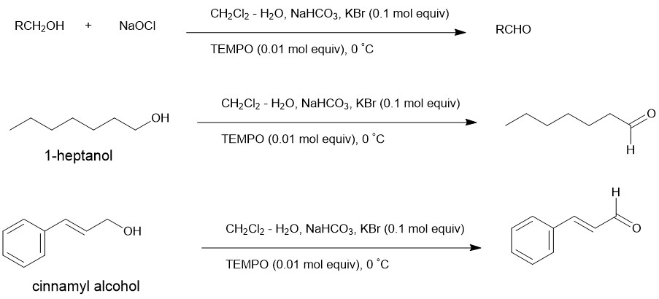
Mild oxidizing agents
iv. TEMPO oxidation “N-O” as the oxidant Sodium hypochlorite (NaOCl, or bleach) is used as the terminal oxidant, TEMPO as the catalyst
NaOCl
NaOCl

Slide 12
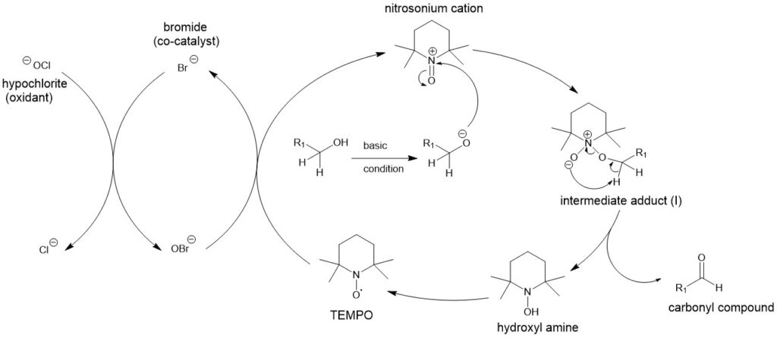
Mechanism: TEMPO as the catalyst
bleach

Slide 13
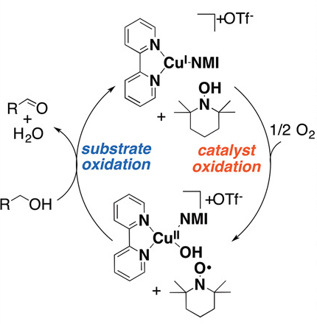
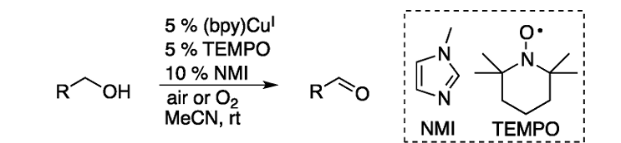
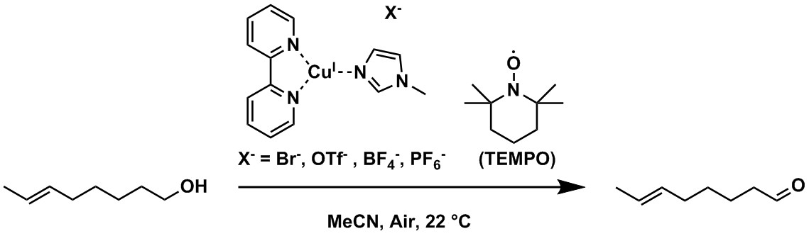
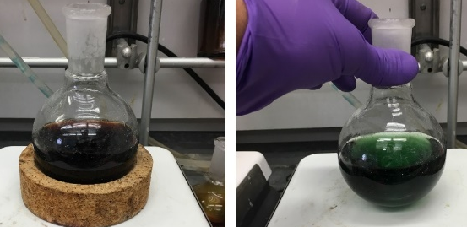
Mild oxidizing agents
iv. Copper(I)/TEMPO-Catalyzed Aerobic Alcohol Oxidation (Stahl oxidation) Oxygen or air is used as the terminal oxidant, TEMPO and Cu as the catalyst Generic scheme: Example (chemoselective):
https://pubs.acs.org/doi/abs/10.1021/ja3117203

Slide 14
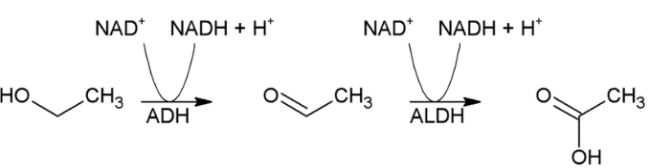
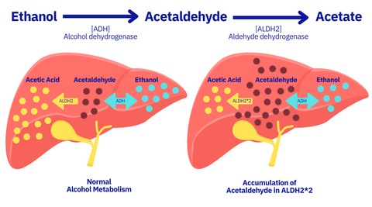
What is “Asian flush” and why?
common in East Asians, with approximately 30 to 50% of Chinese, Japanese, and Koreans
Alcohol or ethanol is broken down or converted in the liver to acetaldehyde, a highly toxic compound that contributes to the hungover feeling. In most people, acetaldehyde is rapidly transformed to harmless acetate and water.
However, for some Asians, Ashkenazi Jews and others whose gene pool contains a mutant or altered form of the ALDH2 gene, the toxic acetaldehyde isn’t broken down as quickly, so it hangs around and accumulates in the liver and body — resulting in what is known as the Asian glow.
https://news.usc.edu/112489/antihistamines-prevent-asian-flush-the-red-face-some-people-get-from-alcohol-but-with-huge-risks/

Slide 15
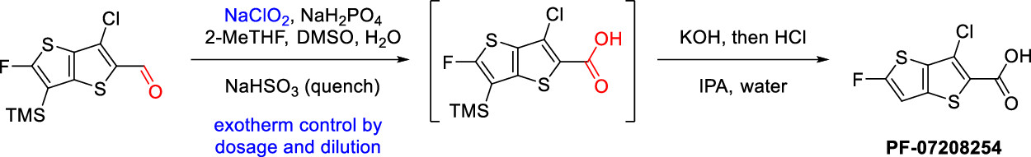

1.2 Aldehydes to carboxylic acids
Pinnick oxidation: (1981) Mild, inexpensive and selective reagent for the oxidation of aldehydes to the corresponding carboxylic acids Reagents: sodium chlorite: NaClO₂ hypochlorous acid (HOCl) is the by-product, and 2-methyl-2butene (or DMSO) is added as the scavenger to prevent side reactions caused by HOCl.
(regio-selectivity)

Slide 16
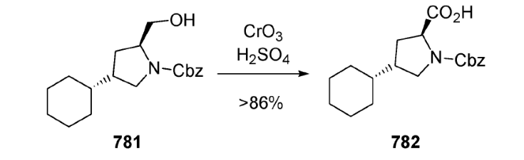
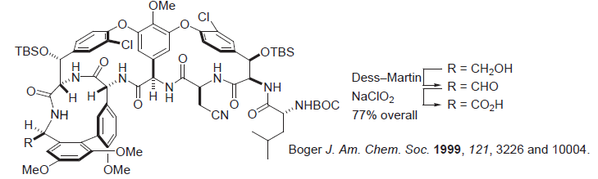
1.3 Primary alcohols to carboxylic acid (strong oxidizing agent)
Jones oxidation (1946)
Reagents: chromic acid (H₂CrO₄), can be prepared by adding chromic trioxide CrO₃ or dichromate salt (Cr₂O₇²⁻) in acetic acid or dilute sulfuric acid
Many functional groups such as amines are often incompatible and need to be protected. For acid sensitive or delicate substrate, Jones reagent is NOT the best choice!
A mild option is to oxidize the alcohol to the aldehyde first, followed by oxidation to the carboxylic acid.

Slide 17

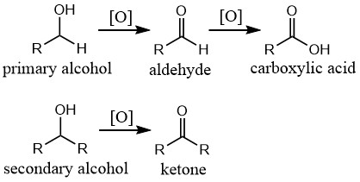
Oxidation of alcohols or aldehydes
1. Mild oxidation: alcohols to aldehydes/ketones Dess Martin Periodinane (DMP) Swern oxidation (large scale) TPAP/NMO MnO₂: allylic/benzylic alcohols TEMPO oxidation Cu(I)-TEMPO aerobic oxidation 2. Aldehydes to carboxylic acids Pinnick oxidation (NaClO₂) + 2-methyl-2butene (or DMSO) 3. Primary alcohols to carboxylic acids Jones oxidation (CrO₃/H₃O⁺) 3 = 1 + 2

Slide 18
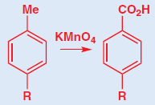
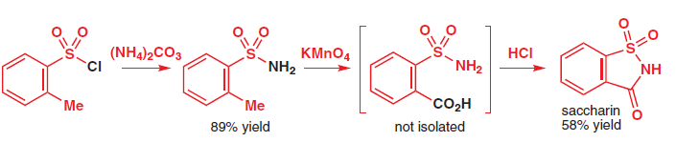
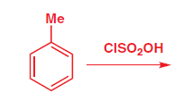

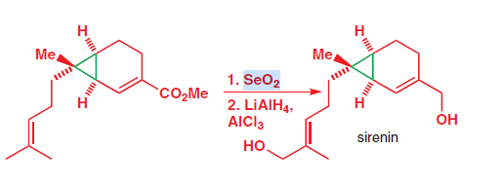
1.4 oxidation of benzylic and allylic C-H bonds
Potassium permanganate is a very powerful oxidant and oxidizes a benzylic methyl group (i.e. a toluene derivative) to a carboxylic acid.
Selenium dioxide, SeO2 oxidizes allylic methyl group to make enals.
(Not applicable to benzylic methyl group)
Mechanism: will be discussed in pericyclic reactions

Slide 19
CM3121 – Advanced Organic Chemistry
Dr. Zhu Ye
Office: S9-14/Tel: 66017501
chmzhu@nus.edu.sg
Synthesis of Alkenes

Slide 20
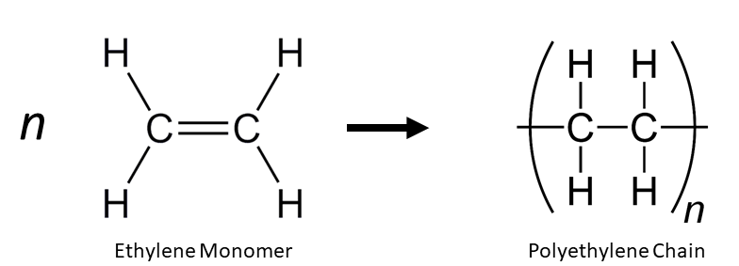
Alkenes from petroleum industry
hydrocarbon cracking
catalytic dehydrogenation
polymerization

Slide 21
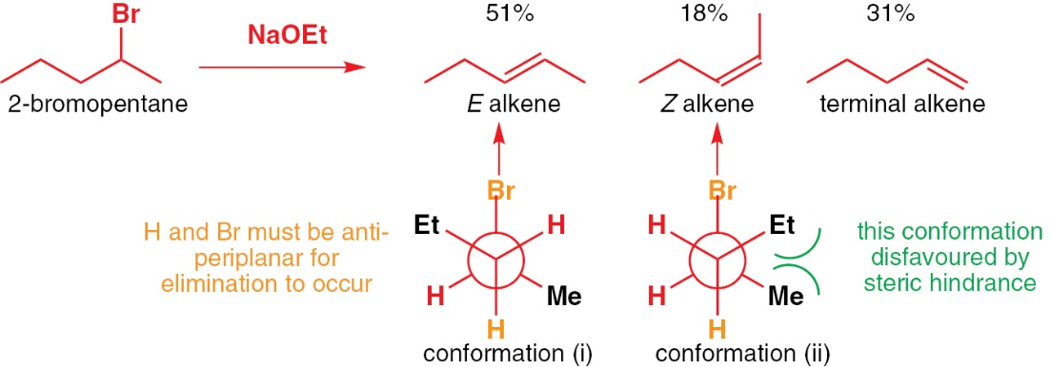
Introduction
Geometrical isomers of alkenes are different compounds: They have different physical, chemical, and biological properties. They are often hard to separate by chromatography or distillation Important for chemists to synthesize them as a single isomer. E2 elimination reactions:

Slide 22
Outlines
Stereoselective synthesis of alkenes from alkynes The Wittig Reaction Ring-closing metathesis and cross-metathesis (future lecture)
Readings:
Clayden 2nd ed; Chapter 27 (p 677-693: The stereoselective synthesis of alkenes)
McMurry 10th ed. Section 19.11 (Wittig reactions) and 17.6 (Reactions of alcohols)

Slide 23
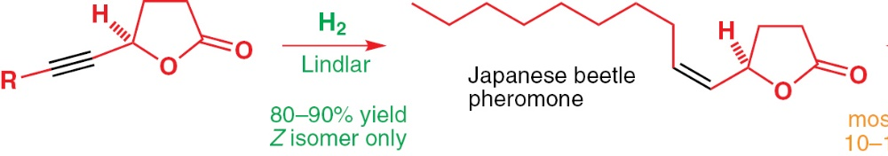
I. Stereoselective synthesis of alkenes from alkynes
Synthesis of Z- alkenes: Alkynes react with H₂ in the presence of Lindlar catalyst (Pd, Pb(OAc)₂ on a support of CaCO₃) to give cis-alkenes To synthesis of E-alkenes: Alkynes react with sodium in liquid ammonia to give E-alkenes

Slide 24
Mechanism
Mechanism: single electron transfer (radicals as intermediates)
radical

Slide 25
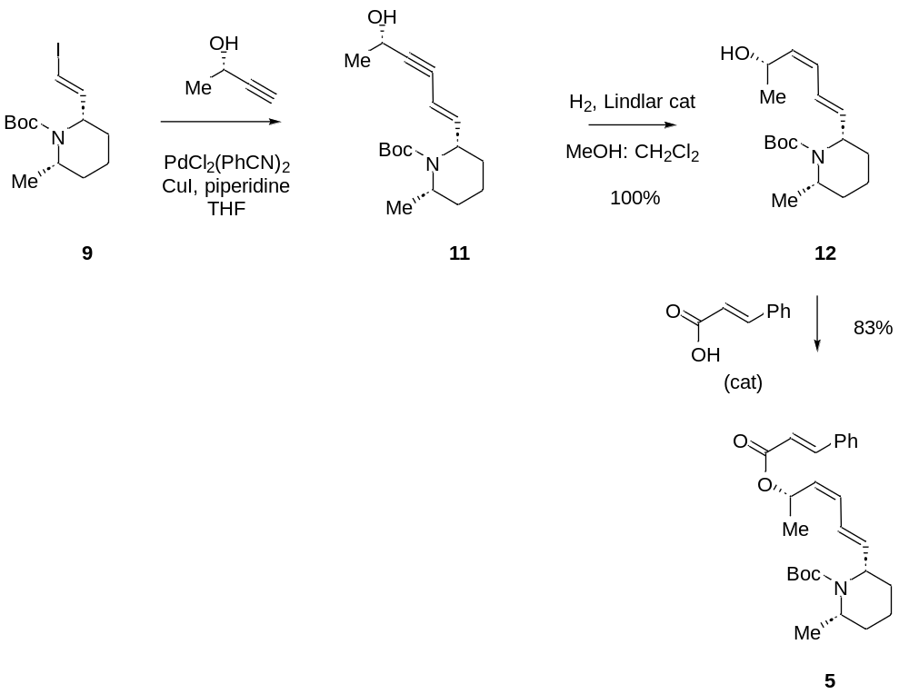
Examples
Org. Lett., Vol. 3, No. 10, 2001

Slide 26
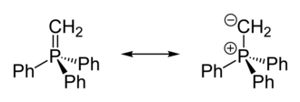
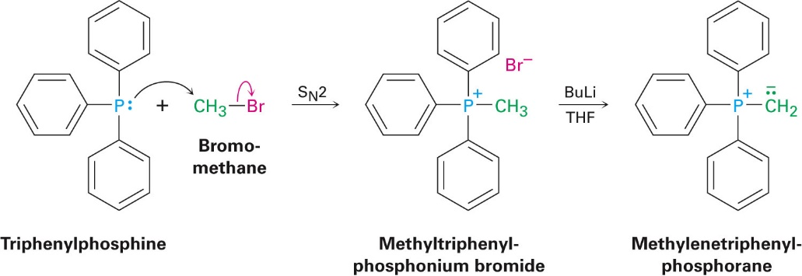
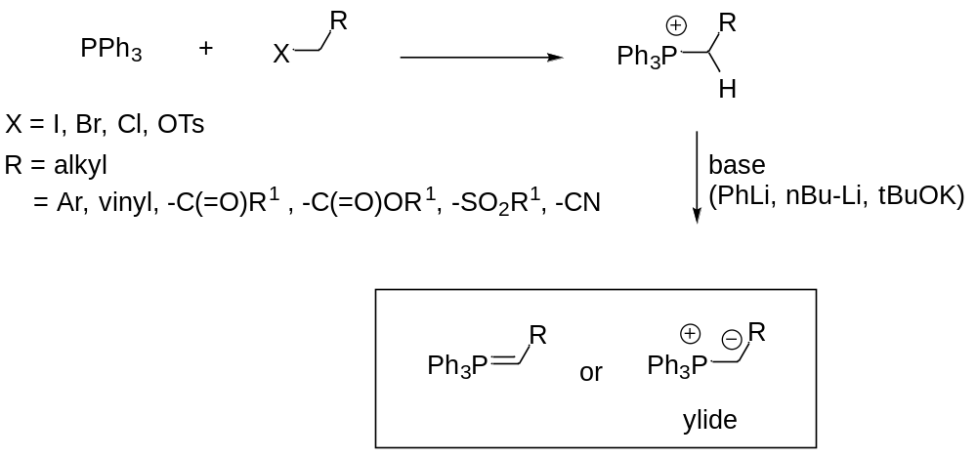
Ylides are 1,2-dipolar compounds
2.1 Ylides
Synthesis of ylide:
Step 1: Phosphonium halide can be prepare from PR₃ and a primary or secondary halide (S_{N}2 reaction)
Step 2: Deprotonation of the C-H next to the phosphonium cation using a base.

Slide 27
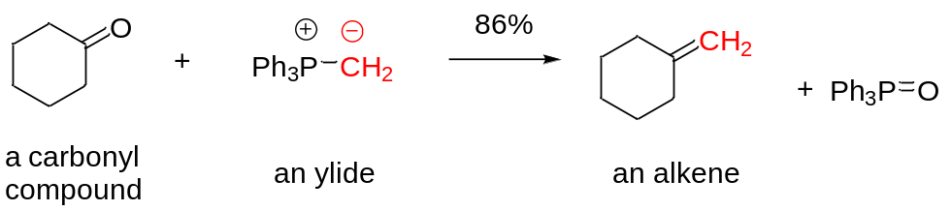
2.2 The Wittig Reaction
Reaction between a carbonyl compound (aldehyde or ketone) and a phosphorous ylide (or phosphorane) to form a C=C double bond (alkene). The phosphorous ylides can be generated before the reaction or in situ
Georg Wittig (1897-1987), was a German chemist. He shared the Nobel Prize in Chemistry with Herbert C. Brown in 1979. Since its discovery in 1950, Wittig reaction has become one the most important and most effective method for the synthesis of alkenes.

Slide 28
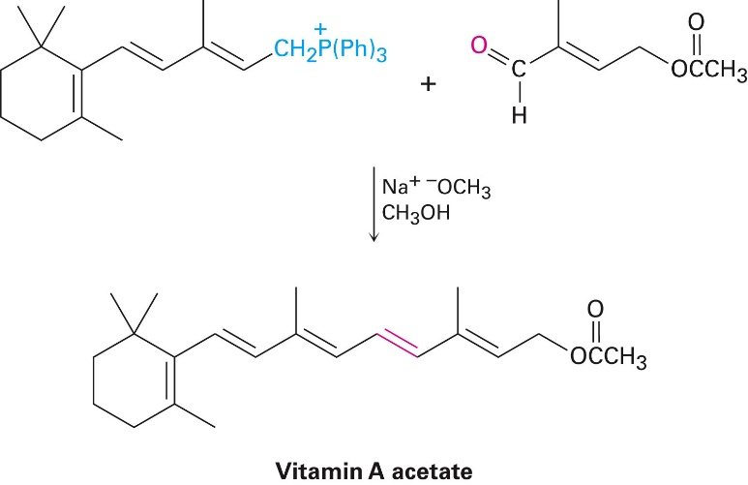
Wittig Reaction
Examples: BASF’s preparation of vitamin A
Notes:
Talk about BASF

Slide 29
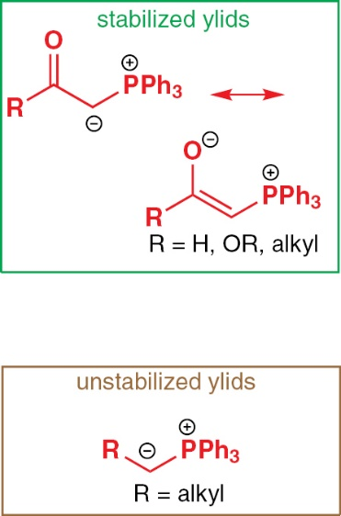
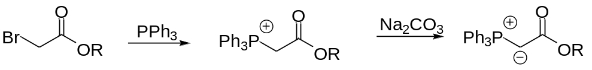
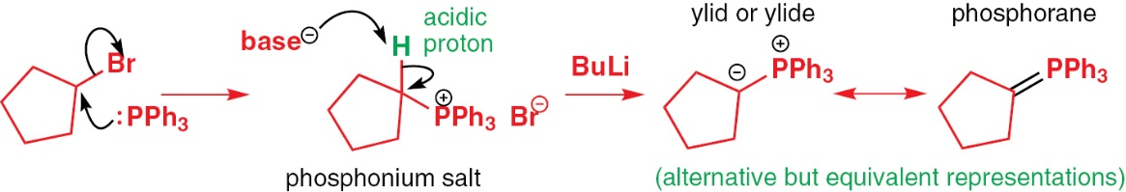
Two types of ylides
Those with conjugating or anion stabilizing substituents adjacent to the negative charge (stabilized ylides) Those without conjugating or anion stabilizing substituents adjacent to the negative charge (unstabilized ylides).

Slide 30
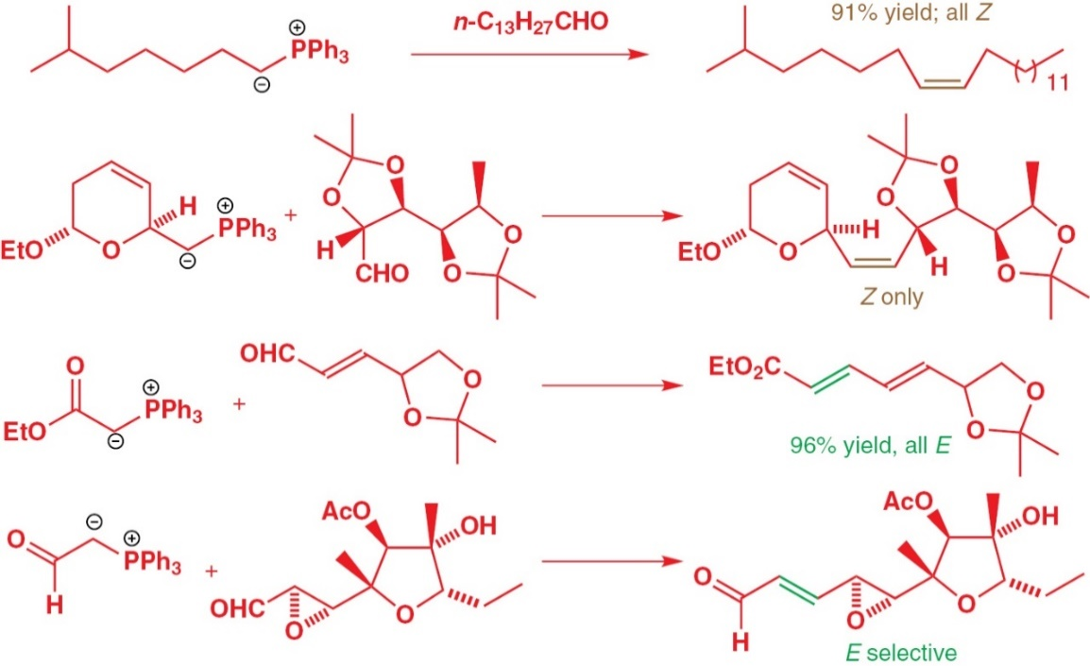
2.3 Stereoselectivity
The general rules for stereochemistry of the Wittig reaction: With stabilized ylides, the Wittig reaction is E-selective

Slide 31

Stereoselectivity
The general rules for stereochemistry of the Wittig reaction: With unstabilized ylides, the Wittig reaction is Z-selective

Slide 32
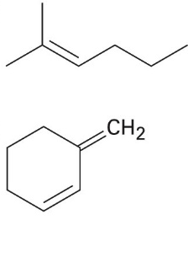
Practice questions
Propose the substrates for the following target molecules through Wittig reactions
Notes:
(McMurry 19.16)

Slide 33

2.4 Mechanism
Ylides are nucleophilic Formation of oxaphosphetane intermediate – which undergoes elimination to give alkene and phosphine oxide as a by-product. The P=O double bond is extremely strong, and it drives the reaction forward

Slide 34


Stereochemistry
Not entirely clear, but a possible explanation:
Z-selective

Slide 35
Stereochemistry
Not entirely clear, but a possible explanation:
Z-selective

Slide 36


2.5 Horner-Wadsworth-Emmons (HWE) reactions
1953: Wittig reported olefin synthesis using phosphonium ylides. 1958: Horner disclosed a modified Wittig reaction employing phosphonate-stabilized carbanion. The scope of the reaction was further defined by Wadsworth and Emmons. Product: High E selectivity for disubstituted alkenes

Slide 37


Horner-Wadsworth-Emmons (HWE) reactions
+

Slide 38
Summary
Stereoselective synthesis of alkenes from alkynes
  Z- alkenes: Hydrogen and Lindlar catalyst
  E- alkenes: Sodium in ammonia
The Wittig Reaction
  Z- alkenes: unstabilized ylide
  E- alkenes: stabilized ylide
  HWE reaction

